Slide 1
P3: “Discussing Things”
ENG 1020
Argumentation/Debate Unit
Month of November 2022

Slide 2
Project Description
Our work will focus on argumentation in public, social, and/or digital spaces. We will think about modality (written text versus oral debate) and best practices such as rhetorical listening and empathy. You will be asked to develop an argument in the form of a.) a written essay b.) a script for a debate between two individuals (online or in-person) and audio-recorded or c.) a narrative of a public meeting using dialogue structure or d.) a recorded or live debate. First, you will must choose a topic or issue to argue. It is important that you choose a topic or issue of which you have some foundational knowledge (now is not the time to take up a cause for which you know nothing about except the name itself). Then, you will determine a space where it is meaningful, relevant and impactful to circulate such an argument. How might seeing, reading or hearing this argument affect the audience?
2700 words or roughly 10 pages *20 minutes of recording material
6 sources (2 popular and 4 scholarly)
DUE November 20th / 250 points or 25% of grade

Slide 3
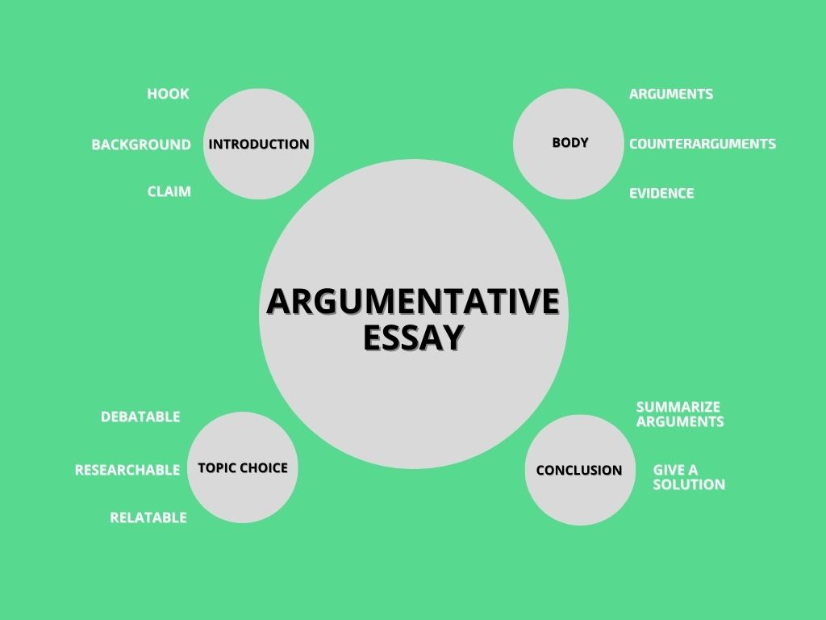
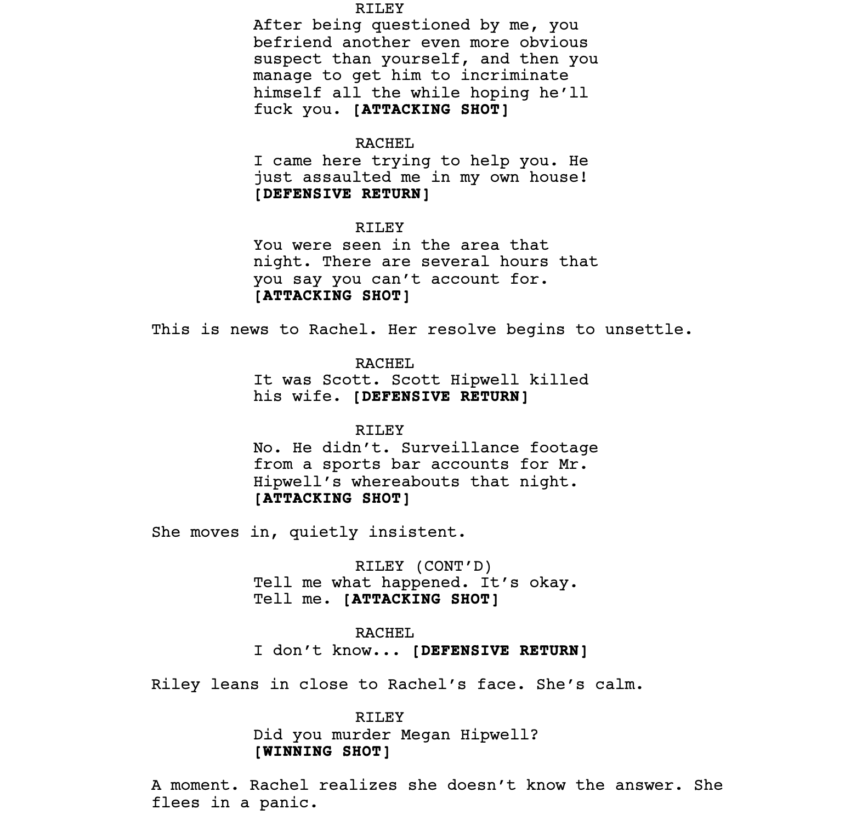
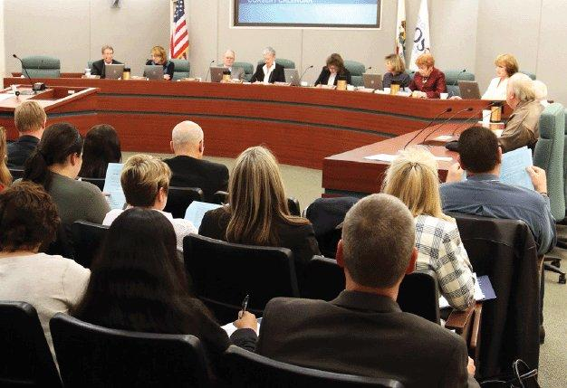
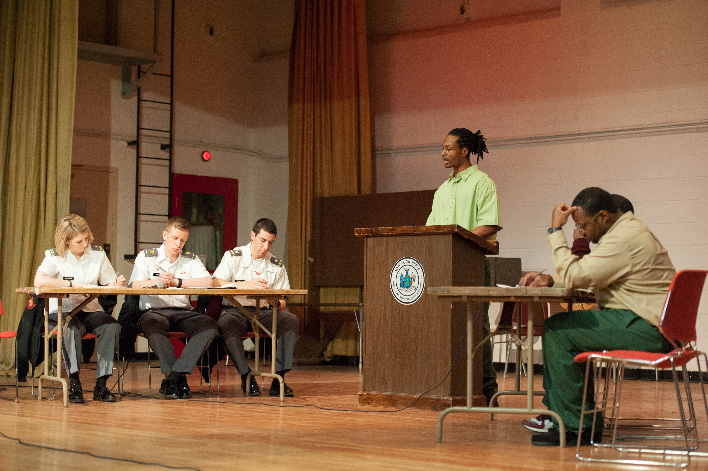
Options
Individual
Academic Essay
Partnered
Argument/Debate between 2 Script & Recording or Thread
Individual/Group
Narrative/Counter Narrative Public Meeting
Group
A Debate Minimum of 5 (2 teams with Moderator)

Slide 4
Academic Essay

Slide 5
Scripted Argument Between 2 People
Written Script & Audio-Recorded (Podcast)
OR
Social Media Thread with suitable graphics and design, NO recording

Slide 6
Public Meeting Narrative/Counternarrative
1 Issue that affects the greater public
-Local or State Issue
-Institutional Issue (Education?)
Must present 3 perspectives, including a counternarrative (inclusion of an individual that this issue directly affects and they speak on behalf of minority or underrepresented)
Could be written in dialogue form and/or recorded

Slide 7
Team Debate
Audio-Visual Recording or LIVE in class
5 students, 2 teams of 2, and a moderator
MUST show evidence of a researched script and plan

Slide 8
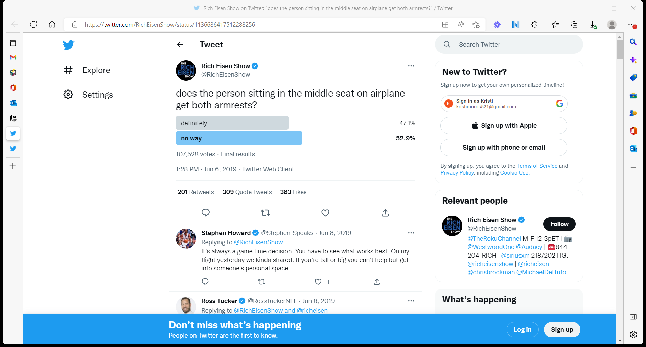
Inspiration Point 1

Slide 9
Inspiration Point 2

Slide 10
Inspiration Point 3

Slide 11
Inspiration Point 4

Slide 12
Inspiration Point 5

Slide 13
Absolute No-No’s
Abortion
Gun Control
Climate Change
Electric Cars
Social Media and Body Image
Technology and Adolescents
Recycling and Composting
Fast Fashion
Legalizing marijuana or other drugs
Lowering drinking age
Free college tuition
Necessity of college degree
School uniforms
Cancel culture
COVID-related issues (vaccine, mandates, or other)
Cellphones and driving
Paid college athletes
Universal healthcare
Assisted suicide
Voting issues (mail-in ballots, fraud, or other)
Death penalty
Minimum Wage
You will NOT be able to address the following issues in this project.

Slide 14
Brainstorming
What issue would be cool to argue?
Do you already know some foundational knowledge about it?
Would you be willing to research BOTH sides of the issue, despite your own position?

Slide 15
Spend the next 5 minutes thinking, chatting and determining how you want to tackle this project.

Slide 16
P3- DJ 1 State the potential problem that you seek to address and argue in one of the optional formats. Then, strategize/ conceptualize how you plan to develop this 3rd project. This ideation phase may also materialize through a storyboard. 100 words DUE by Thursday BEFORE class.

