Slide 1
Week 6: Day 12
P2
October 6th 2022

Slide 2
Review
In Tuesday’s lesson, Week 6 Day 11, we discussed genre, genre conventions, and circulation.
What are some of the more poignant ideas that come up?
Talk to me a bit about the connection between genre, circulation and the rhetorical situation?
P2-PB1 Part 2 is due tonight by 11:59pm
Be sure to have a full 2 pages for each of the 2 elements.
Conferences will be held individually over the next couple weeks, as we work through P2. Be sure to sign-up in the Google doc linked in the Week 6 module.

Slide 3
Student Sample

Slide 4
Student Sample Cont…

Slide 5
Student Sample Cont…
(More element analysis)
So, now what? Suggested revisions?

Slide 6
Let’s Have Some Fun

Slide 7
Stranger Things
(361) The Story of Stranger Things In 3 Minutes! | Arcade Cloud - YouTube

Slide 8
Vecna & Max
(363) Max’s Song (Full Scene) | Kate Bush - Running Up That Hill | Stranger Things | Netflix - YouTube

Slide 9
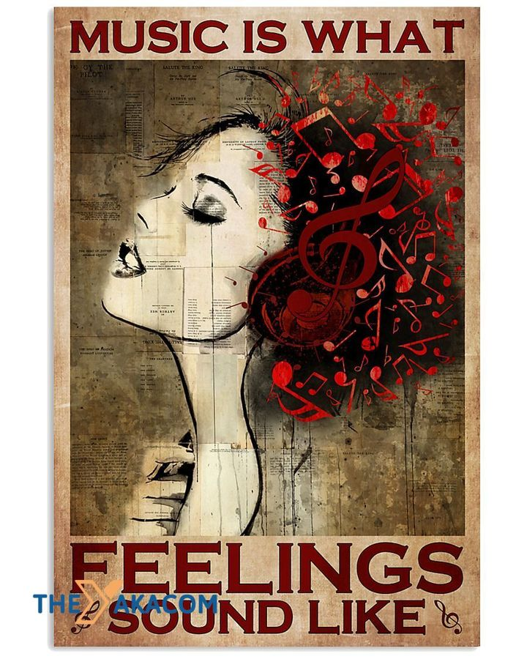
What song would your friends have to play to save your life?

Slide 10
Viewers have “discovered” Kate Bush.
If I only could, I'd be running up that hill If I only could, I'd be running up that hill If I only could, I'd be running up that hill If I only could, I'd be running up that hill
It doesn't hurt me Do you want to feel how it feels? Do you want to know that it doesn't hurt me? Do you wanna hear about the deal that I'm making? You It's you and me
And if I only could I'd make a deal with God And I'd get him to swap our places Be running up that road Be running up that hill Running up that building If I only could, oh...
You don't wanna hurt me, But see how deep the bullet lies Unaware I'm tearing you asunder Oh, there is thunder in our hearts
How does a song become so important? So symbolic?
How does your (chosen) song operate?
Why have you chosen it- what effect does it have?
Think about your connection to the song, the memories it stirs, the immediate feeling you experience.

Slide 11
Genre & Circulation
Tik Tok

Slide 15
What rhetorical choices were made in these parodies?
Tik tok as genre
Conventions and associated expectations
How does Stranger Things and/or “Vecna Song” fit in the space?
Music? Dance?
The vecna song “recirculated”
Originally, the “Vecna Song” was ___________________.
As a parodied by content creators, the “Vecna Song” becomes _______________________________________.
What remains the same?
What has changed?

Slide 16
Design/ Create

Slide 17
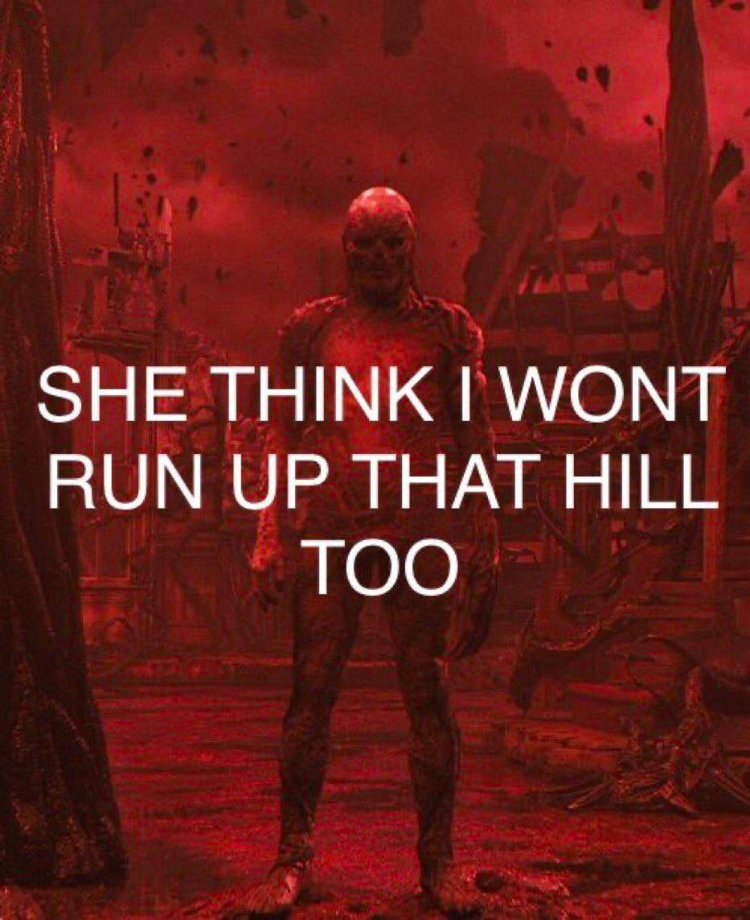
Vecna Song Assignment
Get into groups of no more than 5. You may also work individually.
You have 2 choices:
A. Create an original “Vecna Song” TikTok.
B. Create an audio/visual recording (under 3 minutes)
that includes a clip of your group’s “Vecna Song” and
how or why this would save you.
You will share this work out with the class.
Be creative. Be clever. Have fun. Most importantly, use what you know– rhetorical appeals, devices, etc. What are you trying to convey or show your viewers and listeners?
Submit on Canvas in Week 6 Module

